Slide 1
CS 4530: Fundamentals of Software Engineering
Module 15: Software Engineering & Security
Adeel Bhutta, Jan Vitek and Mitch Wand
Khoury College of Computer Sciences
© 2023, released under CC BY-SA
Notes:
WARNING: THESE SCRIPTS ARE NO LONGER SYNCHRONIZED WITH THE SLIDES. YOU SHOULD REVIEW THEM!

Slide 2
Learning Objectives for this Lesson
By the end of this lesson, you should be able to…
Define key terms relating to software/system security
Describe some of the tradeoffs between security and other requirements in software engineering
Explain 5 common vulnerabilities in web applications and similar software systems, and describe some common mitigations for each of them.
Explain why software alone isn’t enough to assure security
Notes:
WARNING: THESE SCRIPTS ARE NO LONGER SYNCHRONIZED WITH THE SLIDES. YOU SHOULD REVIEW THEM!

Slide 3
Security: Basic Vocabulary 1 (“CIA”)
Security as a set of non-functional requirements
Confidentiality: is information disclosed to unauthorized individuals?
Integrity: is code or data tampered with?
Availability: is the system accessible and usable?
Notes:
Security is often considered a broad functional requirement: systems are expected to be “secure”. As we’ll see in this lecture, security is a spectrum from “very secure” to ”not very secure”, but it’s also a spectrum in terms of the kind of security requirements that we consider. Here are three common security requirements.
Confidentiality - is information disclosed to unauthorized parties? This is not privacy, because the end-user doesn’t get to make a choice. Might make privacy a sub-requirement of confidentiality
Integrity - is our code or data tampered with, at rest, or in transit? usually more of a commercial interest. Someone downloads my customer database is not as bad to my business as someone destroying it
Availability - Can someone prevent my system from otherwise functioning? note that leaving something unplugged solves confidentiality and integrity :)
Discussion: Think about recent examples of security vulnerabiltiies and how they violated these properties

Slide 4
Security: Basic Vocabulary 2
Threat: potential event that could compromise a security requirement
Security architecture: a set of mechanisms and policies that we build into our system to mitigate risks from threats
Vulnerability: a characteristic or flaw in system design or implementation, or in the security procedures, that, if exploited, could result in a security compromise
Attack: realization of a threat
Notes:
WARNING: THESE SCRIPTS ARE NO LONGER SYNCHRONIZED WITH THE SLIDES. YOU SHOULD REVIEW THEM!
(Read slide)
In this lesson we will discuss threats: bad things that could happen that compromise a security requirement. We’ll discuss how we can reason about those threats, and in some cases, try to mitigate them.
We’ll also discuss some vulnerabilities: bugs that make threats more likely to be successful in attacking our systems.

Slide 5

Security isn't (always) free
In software, as in the real world…
You just moved to a new house, someone just moved out of it. What do you do to protect your belongings/property?
Do you change the locks?
Do you buy security cameras?
Do you hire a security guard?
Do you even bother locking the door?
Notes:
Before getting into software security, let’s talk a bit about physical security. Imagine that you have just moved to a new house, and someone just moved out. Are there things that you would want to do to secure your belongings? For instance - do you change the locks? Maybe you are concerned that the former tenant still has keys.
(Walk through example, then ultimately point out that you live in a house with lots of glass)

Slide 6
Security is about managing risk
Cost of attack vs cost of defense?
Increasing security might:
Increase development & maintenance cost
Increase infrastructure requirements
Degrade performance
But, if we are attacked, increasing security might also:
Decrease financial and intangible losses
So: How likely do we think we are to be attacked in way X?
Notes:
We saw in the example of the new home that there may be some security measures that seem needlessly expensive (hiring a security guard) or expensive AND counter to some of our other requirements (replacing glass windows with blast doors increases security at the expense of aesthetics).
Here are some examples of the kinds of tradeoffs that we might consider when thinking about these threats.(read slide)
Ultimately, the last question of “how likely we are to be attacked in some way” is going to be very subjective, and we will need to consider the financial cost of a successful attack – attacks with very large payoffs (for the attacker) might motivate attackers to try harder.

Slide 7
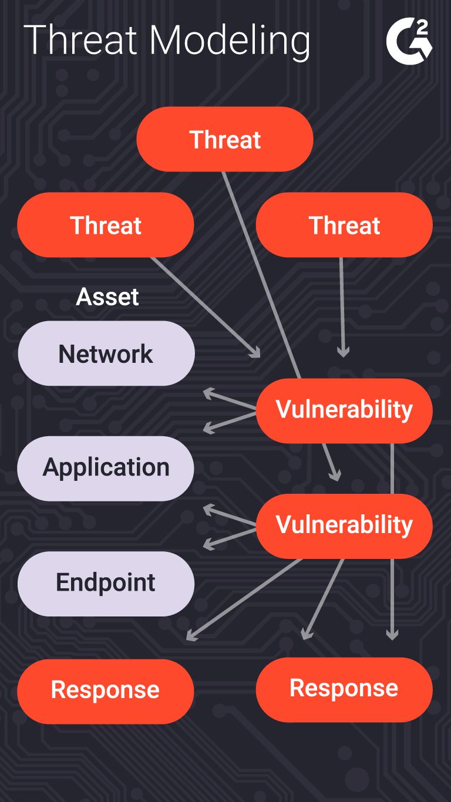
Threat Models help analyze these tradeoffs
What is being defended?
What resources are important to defend?
What malicious actors exist and what attacks might they employ?
What value can an attacker extract from a vulnerability?
Who do we trust?
What entities or parts of system can be considered secure and trusted
Plan responses to possible attacks
Prioritize?
Notes:
The process of considering the potential risks, and ”non risks”, or trusted actors/components, is called “threat modeling”
(read slide)
Note: Usually we trust our code to be bug-free. That’s usually not a great assumption.
And of course there’s a whole ecosystem of consultants to help with this process.

Slide 8
A Baseline Security Architecture (1)
Best practices applicable in most situations
Trust:
Developers writing our code (at least for the code they touch)
Server running our code
Popular dependencies that we use and update
Don’t trust:
Code running in browser
Inputs from users
Other employees (different employees should have access to different resources)
Notes:
Here is a starting point for a security architecture. The details and specifics will depend on your threat model.

Slide 9
A Baseline Security Architecture (2)
Best practices applicable in most situations
Practice good security practices:
Encryption (all data in transit, sensitive data at rest)
Code signing, multi-factor authentication
Encapsulated zones/layers of security (different people have access to different resources)
Log everything! (employee data accesses/modifications) (maybe)
Bring in security experts early for riskier situations

Slide 10
OWASP Top Security Risks
All 10: https://owasp.org/www-project-top-ten/
Broken authentication + access control
Cryptographic failures
Code injection (various forms - SQL/command line/XSS/XML/deserialization)
Weakly protected sensitive data
Using components with known vulnerabilities
Notes:
A good place to start with determine what to do about security in a particular application is to consider the common security risks for that kind of application.
In the context of web apps, the trade group OWASP maintains a top-ten ranking based on their severity and frequency. Here are the top 5. We will discuss some of these specific vulnerabilities, and strategies that you can use to defend against them.

Slide 11
Threats discussed in this lesson:
Threat 1: Code that runs in an untrusted environment
Threat 2: Inputs that are controlled by an untrusted user
Threat 3: Bad authentication (of both sender and receiver!)
Threat 4: Untrusted Inputs
Threat 5: Software supply chain delivers malicious software
Recurring theme: No silver bullet
Notes:
Here are 5 general threats (mostly, but not entirely, aligned with the OWASP list on the preceding slide; sorry about that).
An unfortunate recurring theme that we will see in these defenses is that there is no silver bullet. An extremely motivated attacker (say, a nation-state like the US, China, or Russia) can likely, with enough time and resources, break into anything. But, we will see what we can do to increase the cost of that attack.

Slide 12
Threat 1: Code that runs in an untrusted environment
Authentication code in a web application
function checkPassword(inputPassword: string){
if(inputPassword === 'letmein'){
return true;
}
return false;
}
Should this go in our frontend code?
Notes:
Here’s a broad category of threat: Code that can be controlled by user (e.g. code that runs on a user’s device). Since we can’t trust the user’s runtime (browser, OS, CPU) to faithfully execute exactly our code (and to keep it confidential!), we shouldn’t trust that some authentication code goes in code that runs in a user’s browser.

Slide 13

Threat 1: Code that runs in an untrusted environment
Authentication code in a web application
function checkPassword(inputPassword: string){
if(inputPassword === 'letmein'){
return true;
}
return false;
}
Curses! Foiled Again!
Frontend
Users might be malicious
Trust boundary
We control this side
Backend
Fix: Move code to back end (duh!)
Notes:
The general fix to this is to move that sensitive code into our backend, which we should, hopefully, trust to faithfully execute the code.
(Professor Wand says: yes, this animation is cheesy, but I had way too much fun doing it).

Slide 14


Threat Category 1: Code that runs in an untrusted environment
Access controls to database
Frontend
Database password
Users might be malicious
Trust boundary
We control this side
Database
Fix: Don’t distribute sensitive credentials
Notes:
We really really really should not trust that anything that is distributed in the application that is supplied along with the application. For example: if we have external services (like a database, or some other API, like one for accessing cloud resources), we might be tempted to distribute our database password (or key for third party API) with the application, so that it can directly connect to our database.
The big threat here is that we must implicitly be providing all users with the same access to our database/third party service. Our frontend might try to restrict what data the user can access, but because the user can also use these credentials to directly connect to our database, they will have the power to do whatever is permitted for those credentials.

Slide 15
Threat 2: Data controlled by a user flowing into our trusted codebase
https://xkcd.com/327/
Notes:
The next class of threat that we will consider is: untrusted user inputs. Imagine that we have solved our problem of “do we trust where the code runs” by running that code on our own server that we control. Surely, we still receive inputs from users, who we might not trust.
Here is a pop-culture reference from XKCD that makes jest of this class of threat

Slide 16
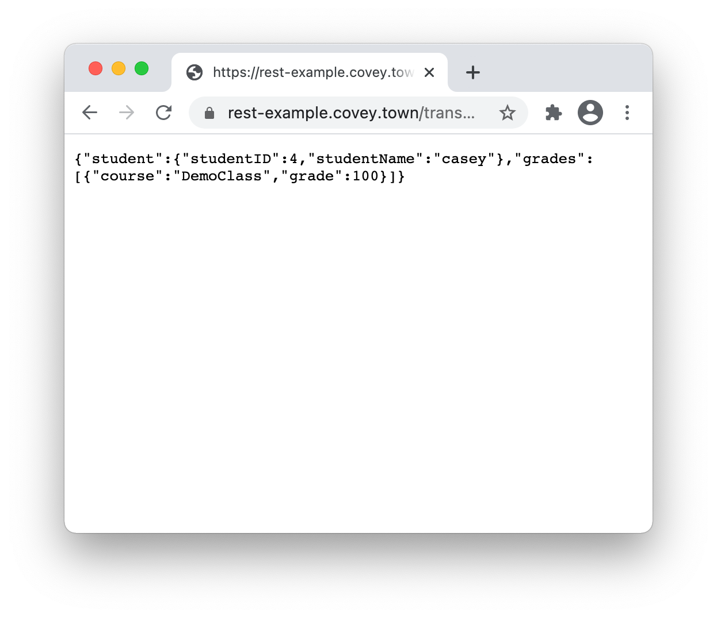
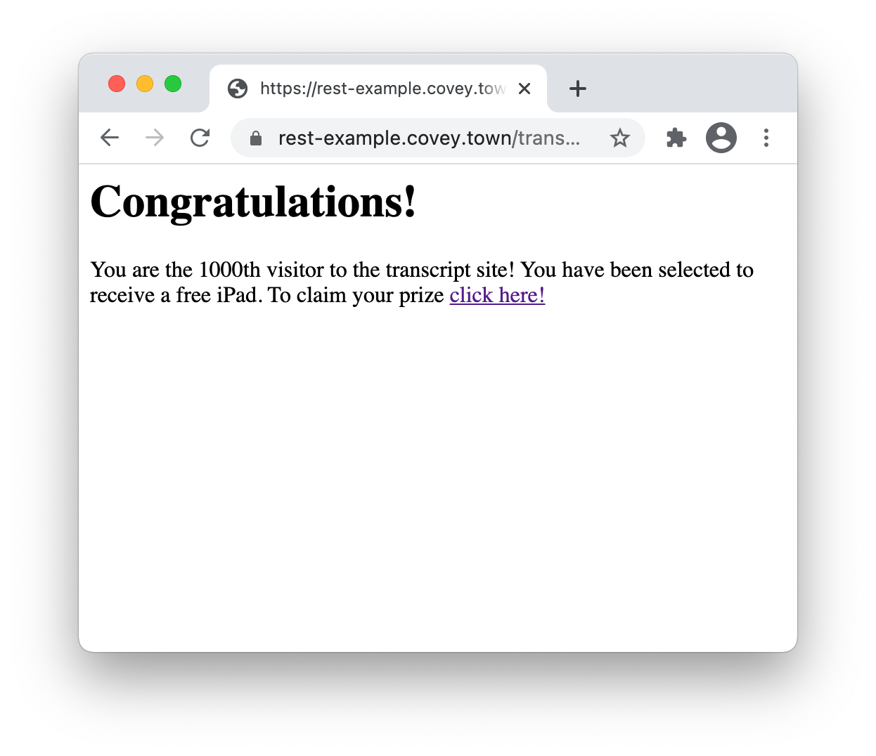
Threat 2: Data controlled by a user flowing into our trusted codebase
Cross-site scripting (XSS) vulnerability
Trusted Server
Malicious JavaScript Response
Notes:
Here is a concrete example of how this threat can be realized in a common web app, even one that doesn’t use a database. (remind of purpose of transcript server ,what this graphic shows – the transcript API and the “fetch transcript” API endpoint)
Click build: We’ll see how it is possible for a malicious attacker to create a link to our own rest example transcript server that, when accessed, shows content that we (the authors of the transcript server) did not intend

Slide 17
Threat 2: Data controlled by a user flowing into our trusted codebase
Cross-site scripting (XSS) vulnerability
app.get('/transcripts/:id', (req, res) => {
// req.params to get components of the path
const {id} = req.params;
const theTranscript = db.getTranscript(parseInt(id));
if (theTranscript === undefined) {
res.status(404).send(`No student with id = ${id}`);
}
{
res.status(200).send(theTranscript);
}
});
Trusted Server
/transcripts/4
Notes:
This semester, we wrote our implementation of the transcript API using the “tsoa” library, which, among other things, effectively prevents XSS attacks against it. So, for our purposes in this example, let’s look at the baseline code that we’ve used in the past, that doesn’t use OpenAPI and code generation to create the API implementation, and instead is directly implemented in the code snippet on the right.
Let’s step through what this code does: read the ID from the Url parameter, then retrieve the relevant transcript. If no transcript is found, we return an error, and if not, we return the transcript.

Slide 18
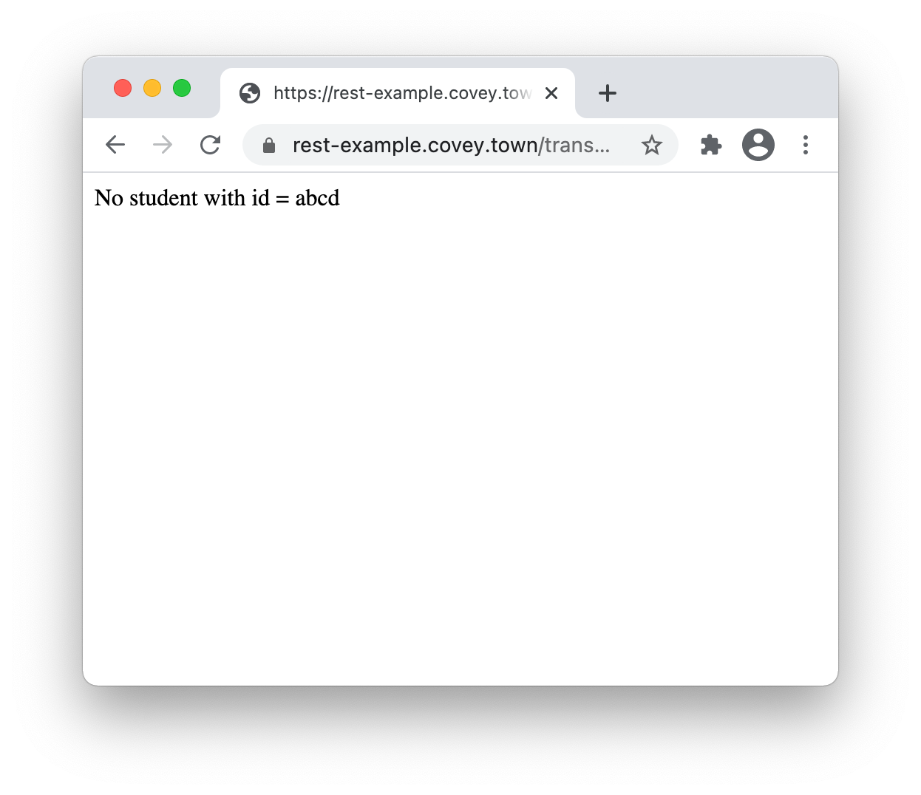
Threat 2: Data controlled by a user flowing into our trusted codebase
Cross-site scripting (XSS) vulnerability
app.get('/transcripts/:id', (req, res) => {
// req.params to get components of the path
const {id} = req.params;
const theTranscript = db.getTranscript(parseInt(id));
if (theTranscript === undefined) {
res.status(404).send(`No student with id = ${id}`);
}
{
res.status(200).send(theTranscript);
}
});
Trusted Server
/transcripts/abcd
Notes:
As highlighted here - notice that there is a user input (the student ID) that flows directly into the response. This is a vulnerabiltity

Slide 19
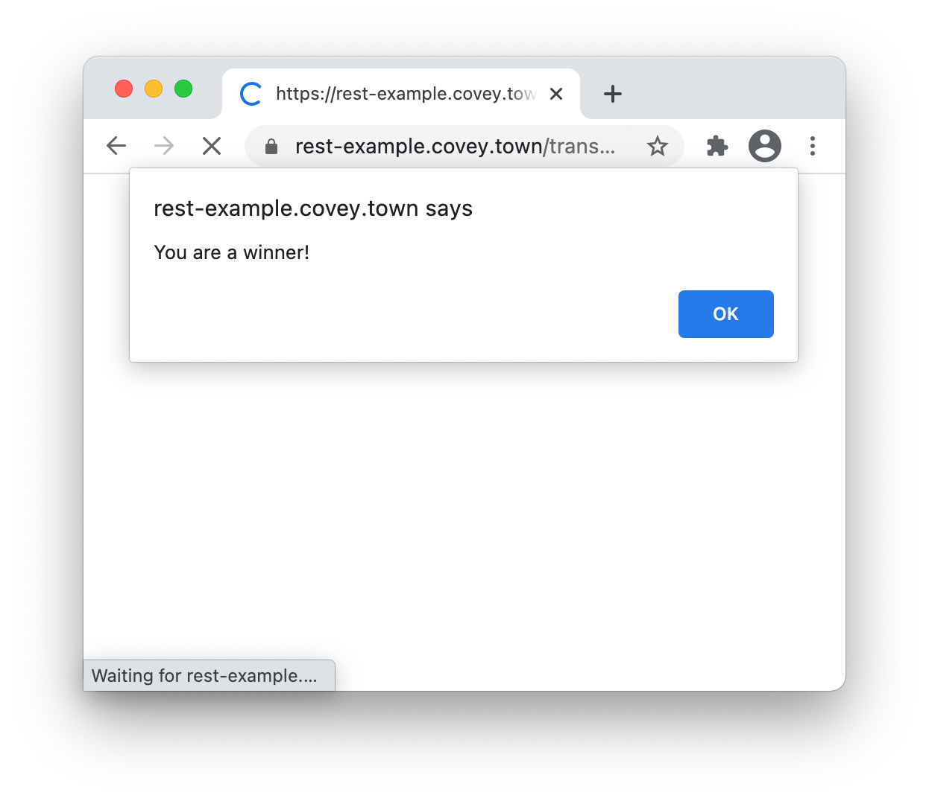
Threat 2: Data controlled by a user flowing into our trusted codebase
Cross-site scripting (XSS) vulnerability
app.get('/transcripts/:id', (req, res) => {
// req.params to get components of the path
const {id} = req.params;
const theTranscript = db.getTranscript(parseInt(id));
if (theTranscript === undefined) {
res.status(404).send(`No student with id = ${id}`);
}
{
res.status(200).send(theTranscript);
}
});
Trusted Server
/transcripts/%3Ch1%3e…
<h1>Congratulations!</h1>
You are the 1000th visitor to the transcript site! You have been selected to receive a free iPad. To claim your prize <a href='https://www.youtube.com/watch?v=DLzxrzFCyOs'>click here!</a>
<script language=“javascript”>
document.getRootNode().body.innerHTML=
'<h1>Congratulations!</h1>You are the 1000th visitor to the transcript site! You have been selected to receive a free iPad. To claim your prize <a href="https://www.youtube.com/watch?v=DLzxrzFCyOs">click here!</a>’;
alert('You are a winner!’);
</script>
Notes:
If, instead of submitting a simple number, the user submits an ID like this one, it will allow the attacker to change the contents on the page.
When you open this link in Chrome, it will show the alert on the left, and then the message on the right.
Realistic XSS attacks might use this JS code to steal users’ credentials from their browser tab, or to perform a social engineering attack like this one

Slide 20
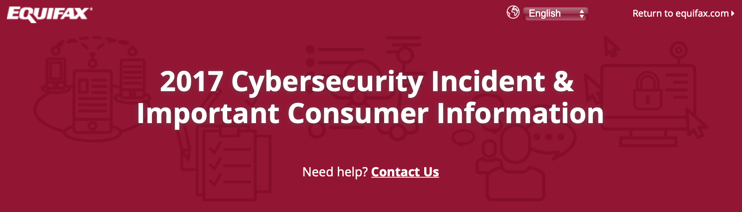
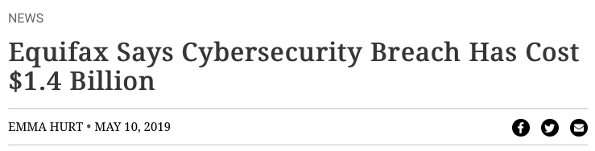
Threat 2: Data controlled by a user flowing into our trusted codebase
Java code injection vulnerability in Apache Struts (@Equifax)
CVE-2017-5638 Detail
Current Description
The Jakarta Multipart parser in Apache Struts 2 2.3.x before 2.3.32 and 2.5.x before 2.5.10.1 has incorrect exception handling and error-message generation during file-upload attempts, which allows remote attackers to execute arbitrary commands via a crafted Content-Type, Content-Disposition, or Content-Length HTTP header, as exploited in the wild in March 2017 with a Content-Type header containing a #cmd= string.
Notes:
Untrusted user inputs can flow into even more risky parts of our app. For example: the Equifax data breach in 2017 that has thus-far cost the firm over 1.4 billion dollars was caused by a vulnerability in their web app, which allowed untrusted user input to flow into a part of the application that would then execute that input as java code.

Slide 21
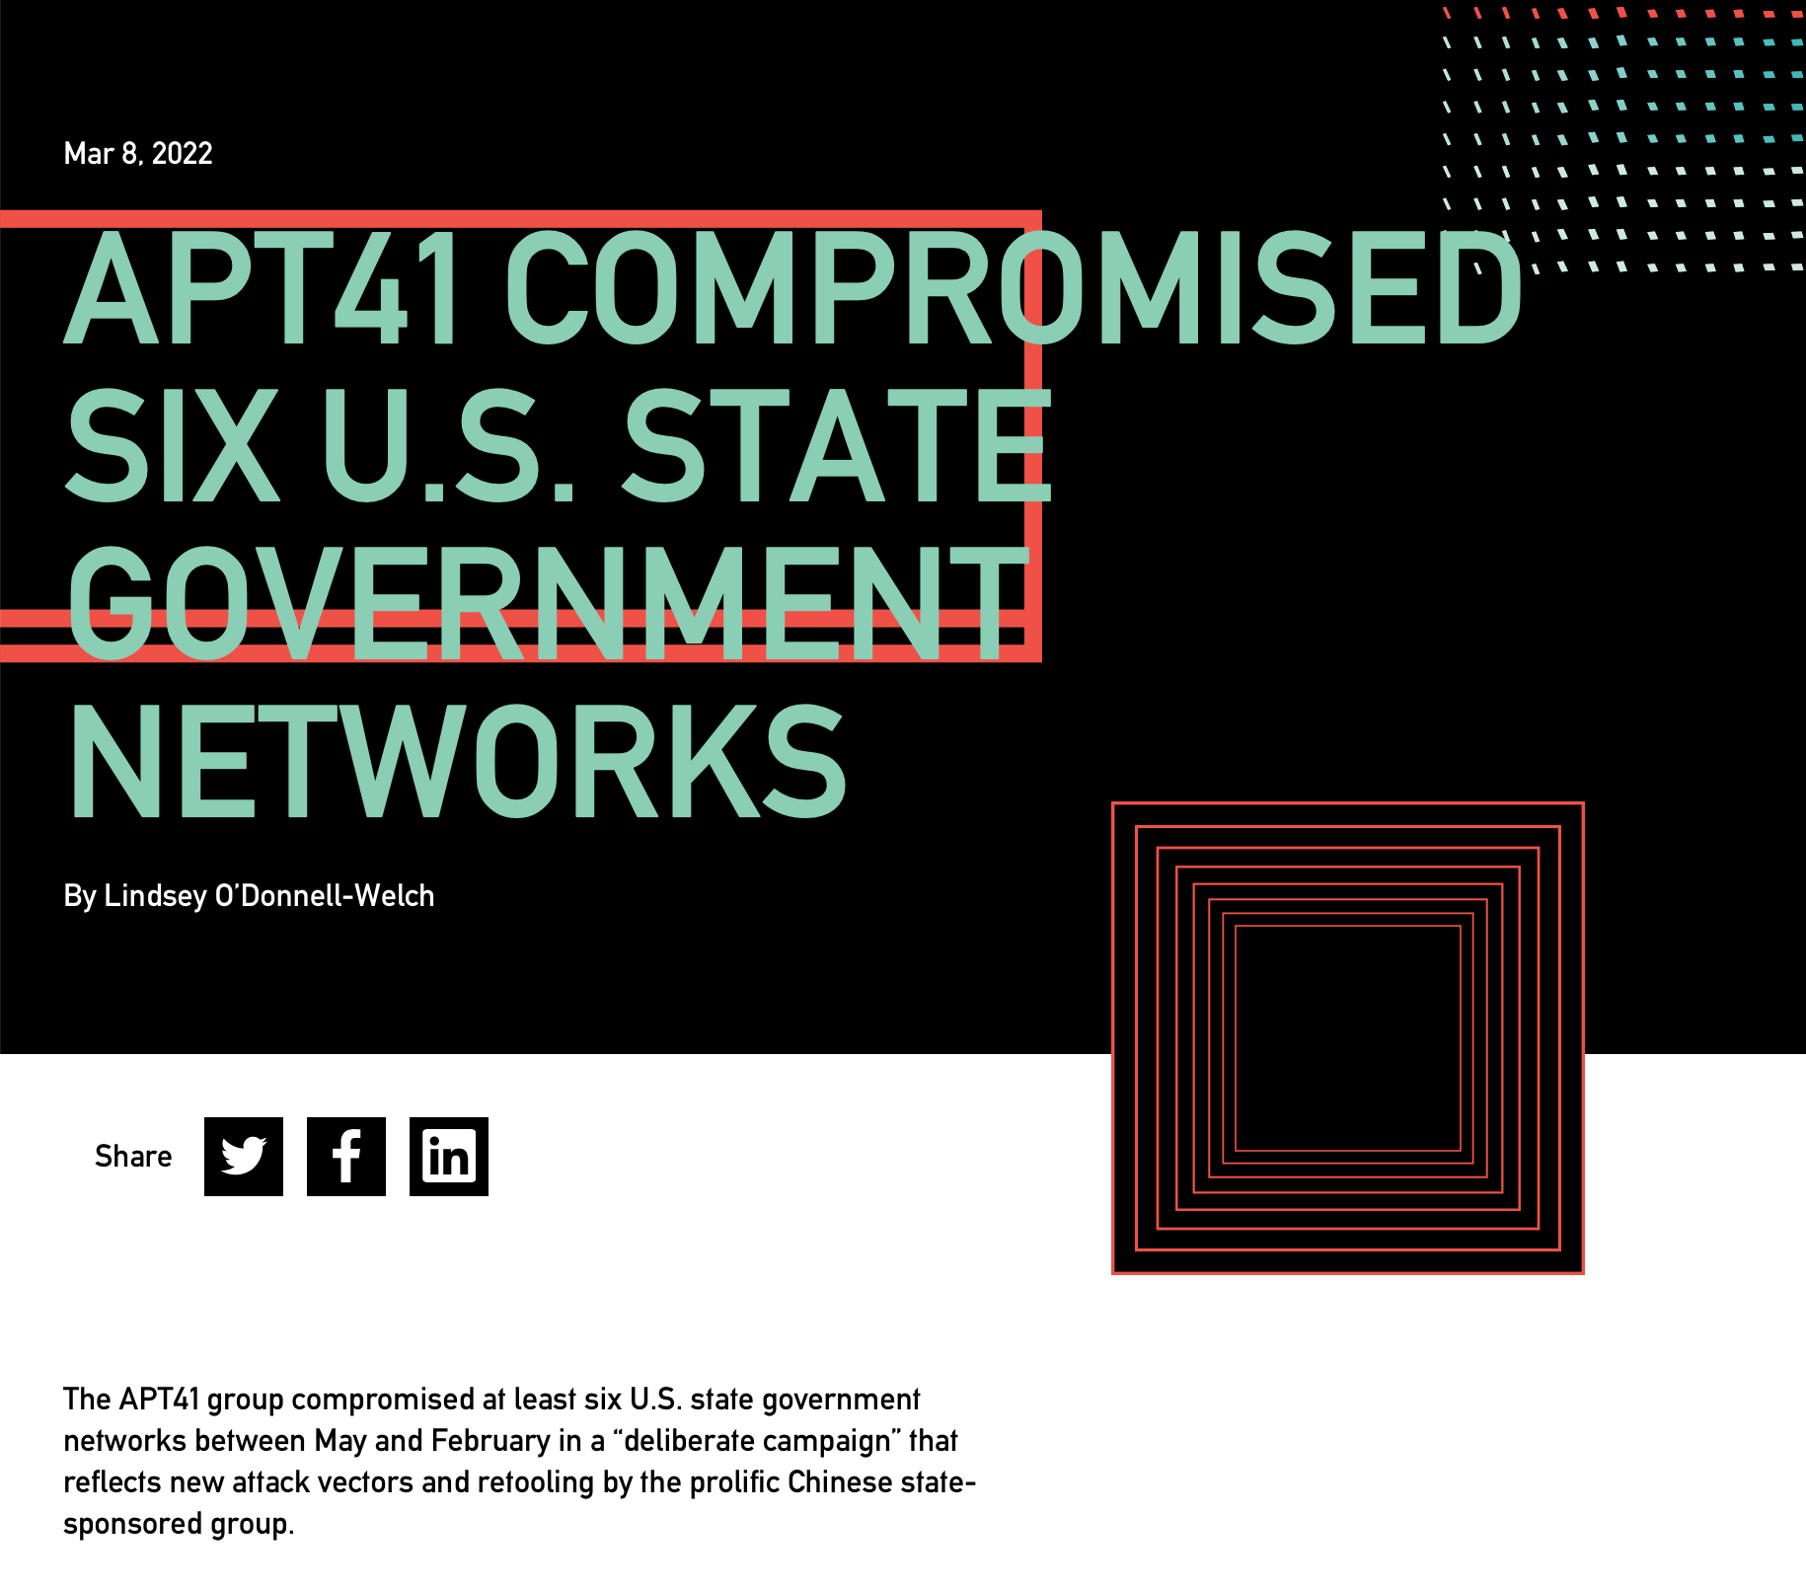
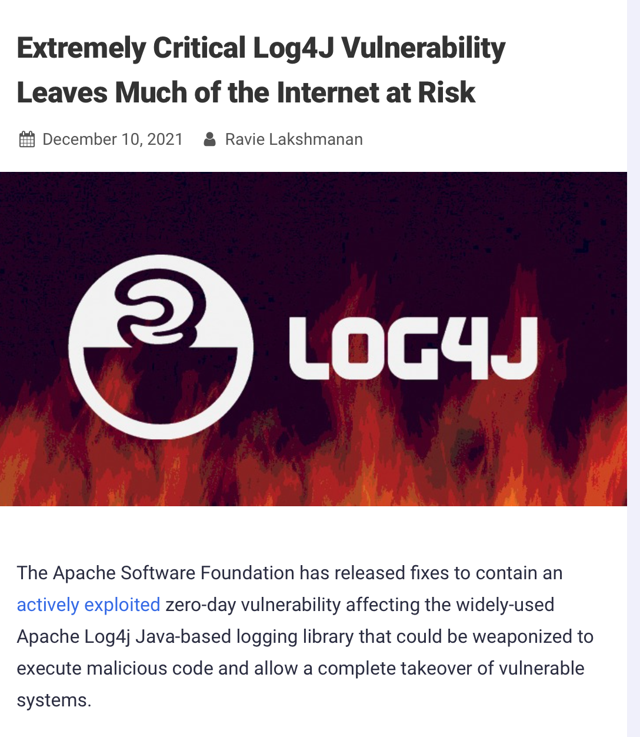
Threat 2: Data controlled by a user flowing into our trusted codebase
Java code injection vulnerability in Log4J
CVE-2021-44228 Detail
Current Description
Apache Log4j2 2.0-beta9 through 2.15.0 (excluding security releases 2.12.2, 2.12.3, and 2.3.1) JNDI features used in configuration, log messages, and parameters do not protect against attacker controlled LDAP and other JNDI related endpoints. An attacker who can control log messages or log message parameters can execute arbitrary code loaded from LDAP servers when message lookup substitution is enabled. From log4j 2.15.0, this behavior has been disabled by default. From version 2.16.0 (along with 2.12.2, 2.12.3, and 2.3.1), this functionality has been completely removed. Note that this vulnerability is specific to log4j-core and does not affect log4net, log4cxx, or other Apache Logging Services projects.
https://nvd.nist.gov/vuln/detail/CVE-2021-44228
https://thehackernews.com/2021/12/extremely-critical-log4j-vulnerability.html
https://duo.com/decipher/apt41-compromised-six-state-government-networks
Notes:
You might think that we have learned a lesson and that we wouldn’t have this kind of vulnerability any more. As we will see in the next lesson, fully protecting against vulnerabiltieis like these is hard. The Log4J vulnerability in Fall of 2021 was successfully used to compromise many networks, and (click build) was also due to an issue where user-controlled inputs could be executed as code on a trusted component (the directory/LDAP server in this case)

Slide 22

Threat 3: Bad authentication
HTTP Request
HTTP Response
client page
(the “user”)
server
Do I trust that this request really came from the user?
Do I trust that this response really came from the server?
Notes:
The obvious solution to “Code that runs in an untrusted environment” is to run that code in a trusted environment. However, this then brings up an immediate concern: how do we make sure that the USER can trust that they are really talking to our server (that we trust)? It would be bad if, a user who is logging into our app sends their username and password to a malicious server (not ours)

Slide 23


Threat 3: Bad authentication
Might be “man in the middle” that intercepts requests and impersonates user or server.
HTTP Request
HTTP Request
Fix (imperfect): Use https and SSL
HTTP Response
HTTP Response
client page
(the “user”)
malicious actor
“black hat”
server
Do I trust that this request really came from the user?
Do I trust that this response really came from the server?
Notes:
Broadly, the threat is that some malicious actor might be able to intercept the user’s communication with our trusted server, breaking confidentiality and integrity of that data

Slide 24
Threat 3: Bad authentication
Preventing the man-in-the-middle with SSL
HTTP Request
HTTP Response
client page
(the “user”)
server
amazon.com certificate
(AZ’s public key + CA’s sig)
Notes:
SSL solves this problem by encrypting traffic between the user and the server, and providing the user with a certificate that the user can trust to identify that the server is really who it says it is (amazon.com in this example)

Slide 25
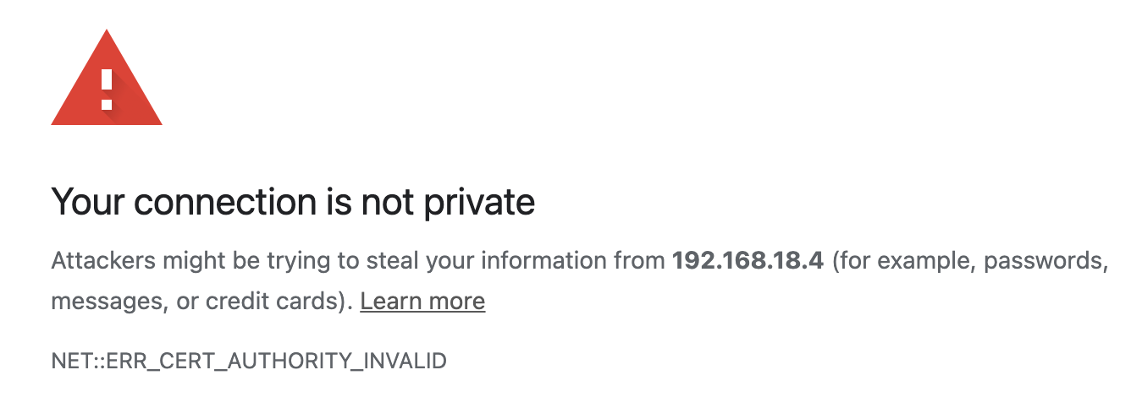
Preventing the man-in-the-middle with SSL
HTTP Request
Encrypted request
Curses! Foiled Again!
HTTP Response
Encrypted response
client page
(the “user”)
server
amazon.com certificate
(AZ’s public key + CA’s sig)
Notes:
Now, if there is a man-in-the-middle, the user can notice this immediately, and not transmit any information to the untrusted server

Slide 26
SSL: A perfect solution?
Certificate authorities
A certificate authority (or CA) binds some public key to a real-world entity that we might be familiar with
The CA is the clearinghouse that verifies that amazon.com is truly amazon.com
CA creates a certificate that binds amazon.com's public key to the CA’s public key (signing it using the CA’s private key)
Notes:
How does SSL work? Is it a perfect solution?
(read slide)

Slide 27
Certificate Authorities issue SSL Certificates
Certificate Authority
Amazon
CA private key
CA private key
amazon.com certificate
(AZ’s public key + CA’s sig)
amazon.com private key
CA public key
My Laptop
amazon.com public key
amazon.com public key
Some real-world proof that we are really amazon.com
CA public key
amazon.com certificate
(AZ’s public key + CA’s sig)
Notes:
Certificate authorities create SSL certificates using asymmetric (aka public/private key) cryptography.
Here is a a brief overview of the trust relationships when an SSL certificate is granted, and when it is checked by a browser.
The process starts out as follows:
Amazon.com has some public key and private key
Certificate authority has some public key and private key
Everyone who trusts the CA has the CA’s public key. This is distributed with OS’s. That is, we must trust the CA.
(build until proof of amazon.com appears on right) To acquire a certificate, Amazon.com will share their public key and some real-world proof that they are amazon.com to the CA
(build until certificate appears and moves back to left) the CA will use their private key to sign amazon’s public key, noting that they are endorsing this public key as being held by amazon.com
(build once) then, when we visit amazon.com, the server will present its certificate, which our browser can validate by checking that it is signed by the CA’s private key (which we do using the public key)

Slide 28
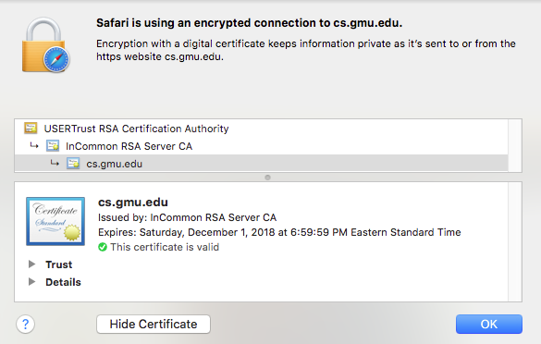
Certificate Authorities are Implicitly Trusted
Note: We had to already know the CA's public key
There are a small set of “root” CA’s (think: root DNS servers)
Every computer/browser is shipped with these root CA public keys
Notes:
(read slide)

Slide 29
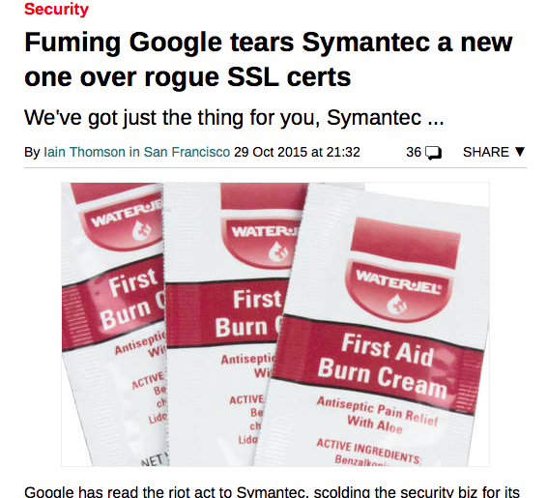
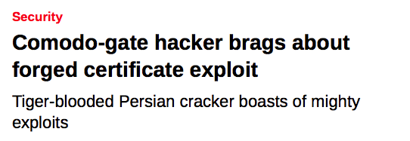
Should Certificate Authorities be Implicitly Trusted?
Signatures only endorse trust if you trust the signer!
What happens if a CA is compromised, and issues invalid certificates?
Not good times.
Notes:
(read slide, build in the two examples, both of which involved CA compromises)
As we saw, placing code in a trusted environment and using SSL to protect communication between trusted components is a great approach to mitigate threats to our execution environment (although it’s not a silver bullet).
Next, we’ll discuss threats posed by untrusted user inputs

Slide 30
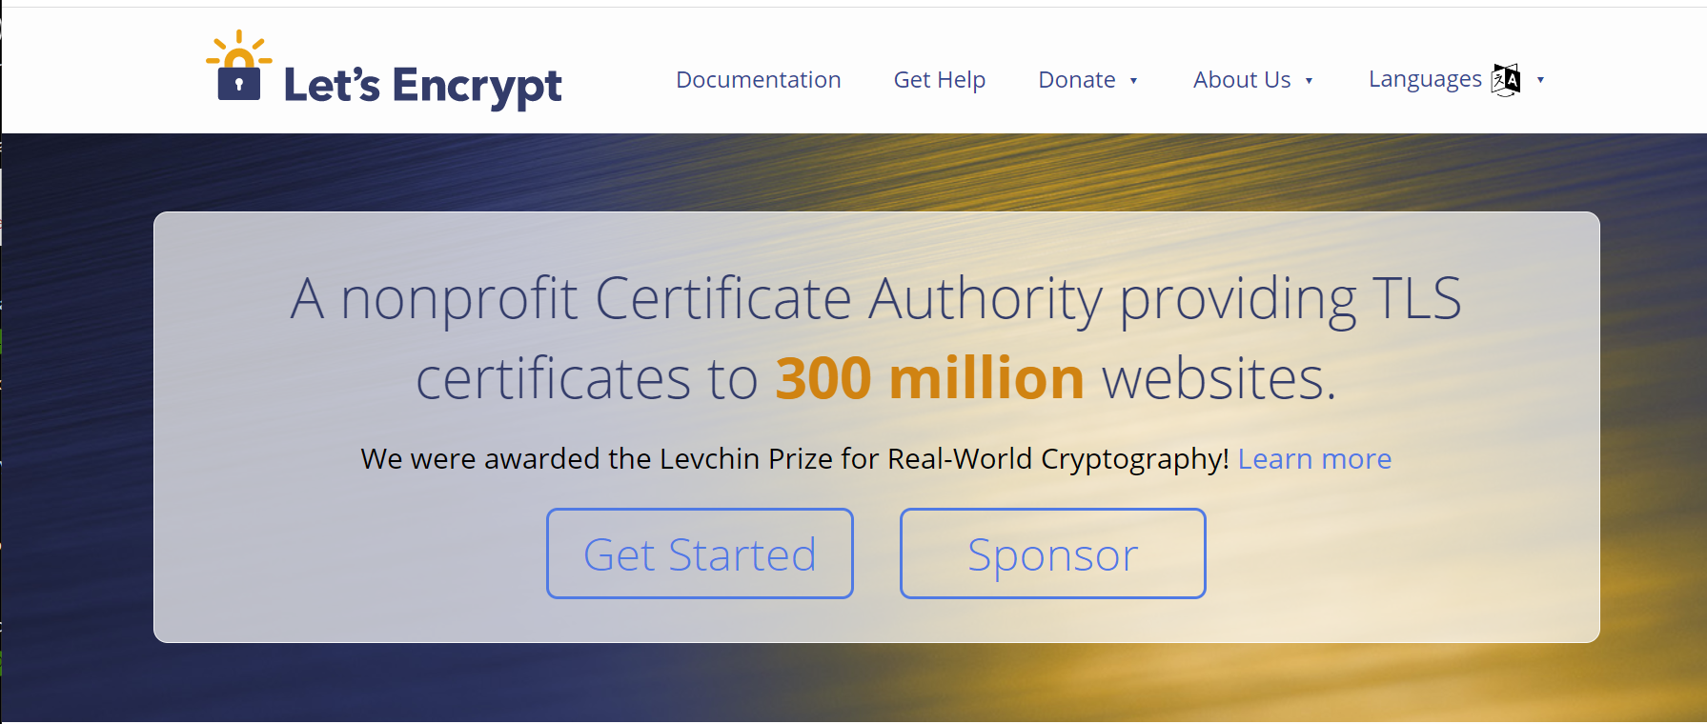
You can do this for your website for free
letsencrypt.com

Slide 31
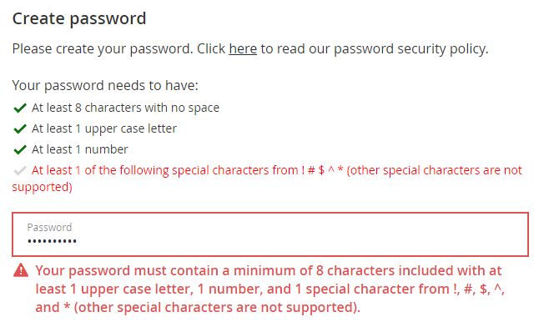
Threat 4: Untrusted Inputs
Restrict inputs to only “valid” or “safe” characters
Special characters like <, >, ‘, “ and ` are often involved in exploits involving untrusted inputs
Fix: Always use input validation
Notes:
(read slide)
Example shows input validation (Good), but it also seems pretty dumb to restrict the space of passwords to not include special characters besides those 5, both in terms of usability (annoying) and security (passwords are easier to guess because fewer possible characters).

Slide 32
Other ways to sanitize your inputs:
Sanitize inputs – prevent them from being executable
Avoid use of languages or features that can allow for remote code execution, such as:
eval() in JS – executes a string as JS code
Query languages (e.g. SQL, LDAP, language-specific languages like OGNL in java)
Languages that allow code to construct arbitrary pointers or write beyond a valid array index
Notes:
Here are some other possibilities for mitigating risks from untrusted inputs.
(read slide, some notes below)
Query languages might have “safe” apis and “unsafe” APIs, where the “Safe” APIs automatically perform some sanitization, allowing you to add place-holders for arguments to a query that YOU define, where the user-controlled input can ONLY flow into a specific part of the query (preventing the attacker from constructing their own query)
Last bullet is about avoiding C, buffer overflows, etc.

Slide 33
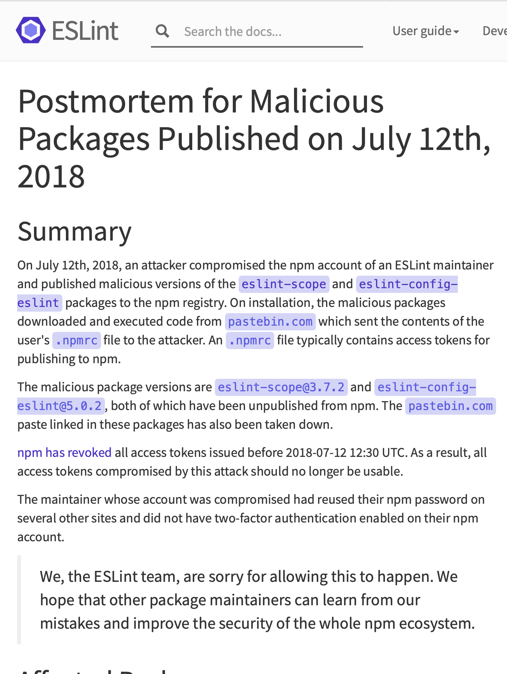
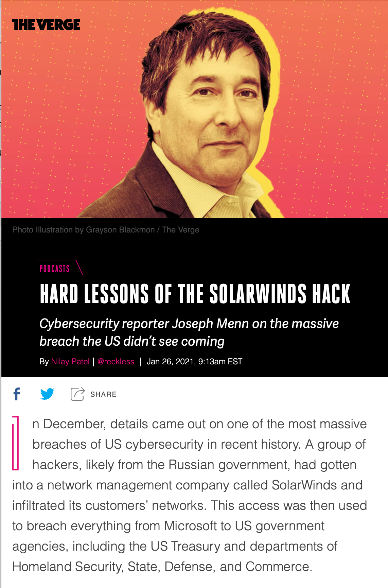
Threat 5: Software Supply Chain
Do we trust our own code? Third-party code provides an attack vector
https://www.theverge.com/2021/1/26/22248631/solarwinds-hack-cybersecurity-us-menn-decoder-podcast
https://eslint.org/blog/2018/07/postmortem-for-malicious-package-publishes
Notes:
Lastly, we will consider, broadly, so-called software supply chain threats. This category of threat captures everything bad that might happen when we develop software.
For example:
(Left) We often rely on many third-party dependencies. A motivated attacker might be able to (through some other vulnerabilities) be able to publish a malicious version of that package. There was a quite serious issue when a malicious version of an eslint package, eslint-scope was published. This was introduced when an eslint-scope developer used the same password on another website, did not use 2FA, and their password was leaked from the other website.
(Right) The solar winds attack last year is also a high-profile software supply chain attack, where malicious actors were able to compromise the development process of a major software vendor and embed malware in the software that they then provided to clients.

Slide 34
Threat 5: The software supply chain has many points of weakness
External dependencies
Build process
Distribution process (including updates)
Operating environment
In-house code
Notes:
The “software supply chain” includes many potential points of weakness. We might need to consider threats at each phase of the software development and deployment process, including:
External dependencies: potential for malicious dependencies
In-house code: potential for insider attack (a developer who is either malicious, or whose laptop has been otherwise compromised through another vulnerability)
Build process: potential for build system to be compromised through another vulnerability or insider attack
Distribution process: potential for a malicious update to be pushed out to your customers
Operating environment: potential for other threats in the operating environment to result in a compromise of our software

Slide 35
Common vulnerabilities in top 1% of npm packages
2021 NCSU/Microsoft Study
Package inactive or deprecated, yet still in use
No active maintainers
At least one maintainer with an inactive (purchasable) email domain
Too many maintainers or contributors to make effective maintenance or code control
Maintainers are maintaining too many packages
Many statistics/combinations: see the paper for details.
“What are Weak Links in the npm Supply Chain?” By: Nusrat Zahan, Thomas Zimmermann, Patrice Godefroid, Brendan Murphy, Chandra Maddila, Laurie Williams https://arxiv.org/abs/2112.10165
Notes:
This is a list of significant vulnerabilities found in the most popular packages (“top 1%”).

Slide 36
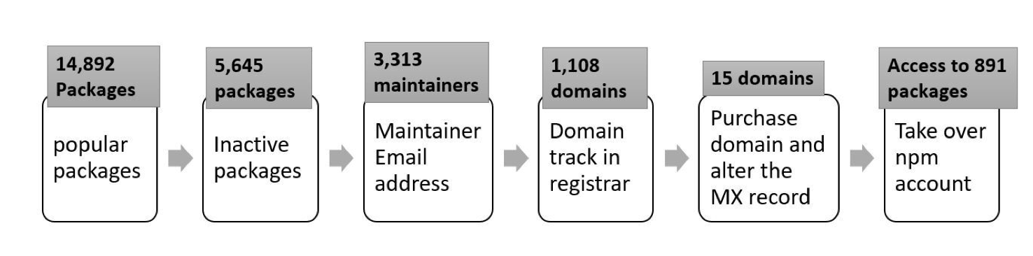
A possible attack…
2021 NCSU/Microsoft Study
“What are Weak Links in the npm Supply Chain?” By: Nusrat Zahan, Thomas Zimmermann, Patrice Godefroid, Brendan Murphy, Chandra Maddila, Laurie Williams https://arxiv.org/abs/2112.10165
Notes:
Study included 1.4m security-sensitive packages on NPM – those that are depended on by others, and also have a license, a source code repository, and are not deprecated.
(read slide for key findings)
The graphic shows a realistic chain of attacks on NPM, starting from popular packages (top 10k by dependents and top 10k by downloads), then filtering to those that are not actively maintained (unlikely that anyone is carefully looking), then those that have email addresses that are expired. Then, for those 1,108 emails, we find the emails with domains that are available for sale by a registrar, finding 15 domains, that if purchased, would allow an attacker to reset the maintainer’s password, allowing takeover of 891 of these popular packages.
Whose job is it to fix this? NPM is motivated here only to sell products to enterprise customers to try to fix things, but it’s really a community problem.

Slide 37
Threat Mitigation: Software Supply Chain
Process-based solutions for process-based problems
External dependencies
Audit all dependencies and their updates before applying them
In-house code
Require developers to sign code before committing, require 2FA for signing keys, rotate signing keys regularly
Build process
Audit build software, use trusted compilers and build chains
Distribution process
Sign all packages, protect signing keys
Operating environment
Isolate applications in containers or VMs
Notes:
While we could easily solve problems in our own code by bolting on some useful additional components (like using SSL), it’s not so easy to solve threats to our software supply chain process – there need to be process-based solutions for these process-based problems.
These kinds of threats are currently some of the most-talked about (and most feared) because they are complex to defend against.
For example: how do we audit dependencies? Who does that, and when? What is “secure enough” for a dependency?
Who loves needing to do 2FA for every time you sign into canvas? How much worse is it if you had to do it for each git commit?
Signatures are useful only insofar as we trust the signer. If a developer’s computer is compromised (say, through a phishing attack), what good is that signature? Same for distribution.
Perhaps the best news-you-can-use here is to isolate each application in its own container or VM, reducing the scope of security breaches to be isolated within that environment and not directly impacting other applicaitons

Slide 38
Building a security architecture
Security architecture is a set of mechanisms and policies that we build into our system to mitigate risks from threats
Vulnerability: a characteristic or flaw in system design or implementation, or in the security procedures, that, if exploited, could result in a security compromise
Threat: potential event that could compromise a security requirement
Attack: realization of a threat
It’s a management problem!!
Notes:
All the mitigations in the world won’t help you if you can’t get the people in your organization to use them.
As David Blank-Edelman(*) used to say: “the solution is in front of the screen, not behind it.”
(*) former head of Systems at Khoury

Slide 39
Which threats to protect against, at what cost?
Consider various costs:
Performance:
Encryption is not free;
C may be faster than Typescript, but is vulnerable to buffer overflows, etc.
Expertise:
It is easy to try to implement these measures, it is hard to get them right
Financial:
Implementing these measures takes time and resources
Notes:
So, where do we stand? We have discussed some threats, and some broad classes of defenses. Each of these defenses comes at some cost.
(read slide; the C/TS thing is about buffer overflows being a huge problem in C but obivoulsy not in TS)

Slide 40
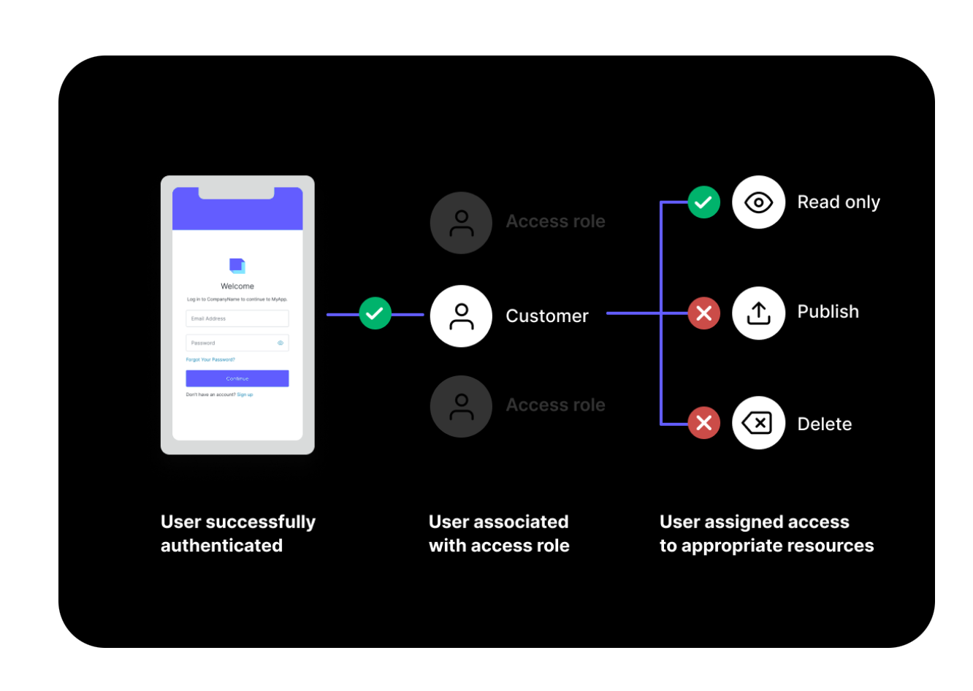
Broken Authentication + Access Control
OWASP #1
But how to get your developers to do this? Always.
Use SSL.
Implement multi-factor authentication
Implement weak-password checks
Apply per-record access control
Harden account creation, password reset pathways
The software engineering approach: rely on a trusted component
Auth0
It’s a management problem!!
https://auth0.com
Notes:
Broken access controls are the most common class of vulnerability on OWASP’s 2021 list, and involve issues such as:
Bypassing access control checks by tampering with URLs or directly making API requests
Permit viewing/editing of other users’ content that is normally protected by “secret” URLs, where those secret identifiers are inadvertently disclosed
Privilege escalaltion – attackers can masquerade as other users
General fixes on slide.
“Auth 0” is a third-party service that provides a generic authentication and access management for your application. Using a third-party service like this that can be trusted to “do this right” is a great software engineering strategy.

Slide 41
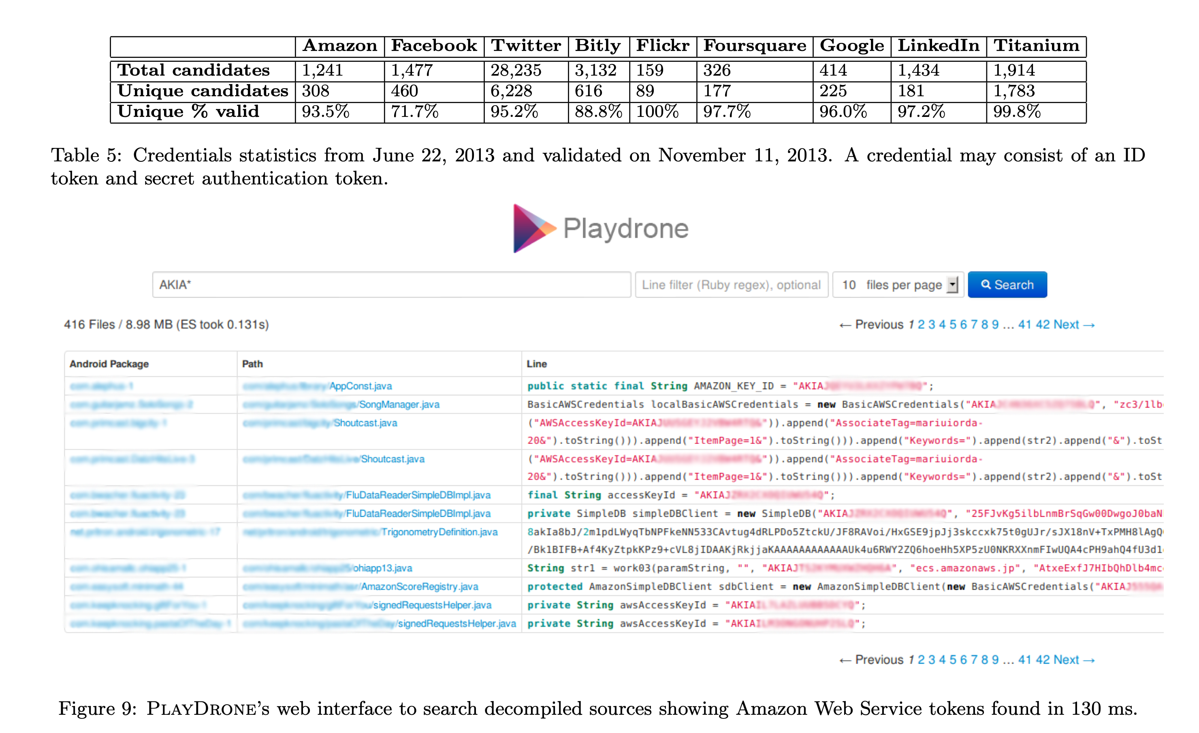
Cryptographic Failures
OWASP #2
But how to get your developers to do this. Always.
Enforce encryption on all communication
Validate SSL certificates; rotate certificates regularly
Protect user-data at rest (passwords, credit card numbers, etc)
Protect application “secrets” (e.g. signing keys)
It’s a management problem!!
“A Measurement Study of Google Play,” Viennot et al, SIGMETRICS ‘14
Notes:
General fixes on slide. Notes:
Validation -> certificates should be relatively short time-limited to limit damage in case they are compromised. Hence, important to check and not ignore expiration date of certificate
Application secrets – we talked about that last week in the context of static analysis, it’s what’s shown on the right

Slide 42
Do developers pay attention? Do they have good reason not to?
Industrial study of secret detection tool in a large software services company with over 1,000 developers, operating for over 10 years
What do developers do when they get warnings of secrets in repository?
49% remove the secrets; 51% bypass the warning
Why do developers bypass warnings?
44% report false positives, 6% are already exposed secrets, remaining are “development-related” reasons, e.g. “not a production credential” or “no significant security value”
Is it a management problem or a tool problem?
“Why secret detection tools are not enough: It’s not just about false positives - An industrial case study”
Md Rayhanur Rahman, Nasif Imtiaz, Margaret-Anne Storey & Laurie Williams https://link.springer.com/article/10.1007/s10664-021-10109-y
Notes:
Simply using a secret detection tool isn’t enough. This is an interesting study.
(Read slide for key findings)
Discussion:
Bypassing warnings for false positives (e.g. not an actual credential) are reasonable (although perhaps annoying); the remaining reasons that are “development related” such as: * It is not a production credential (for example, it is a credential for a non-shipping prototype)
The credential doesn’t protect any data, service, etc., with significant security value
Rely on judgement calls of the developer that do not reflect overall security model. Many successful attacks rely on chaining multiple vulnerabilities together, getting a foothold in one system to then be able to access another. These kinds of judgement calls should not be made at the level of individual developers who may not see the whole security landscape.
Other reasons why secrets not promptly removed:
* Removing the credential now would break services. etc., that belong to other teams
* We were not sure what secret management/other solution we can use to resolve the problem.
These are process-related issues, and require

Slide 43
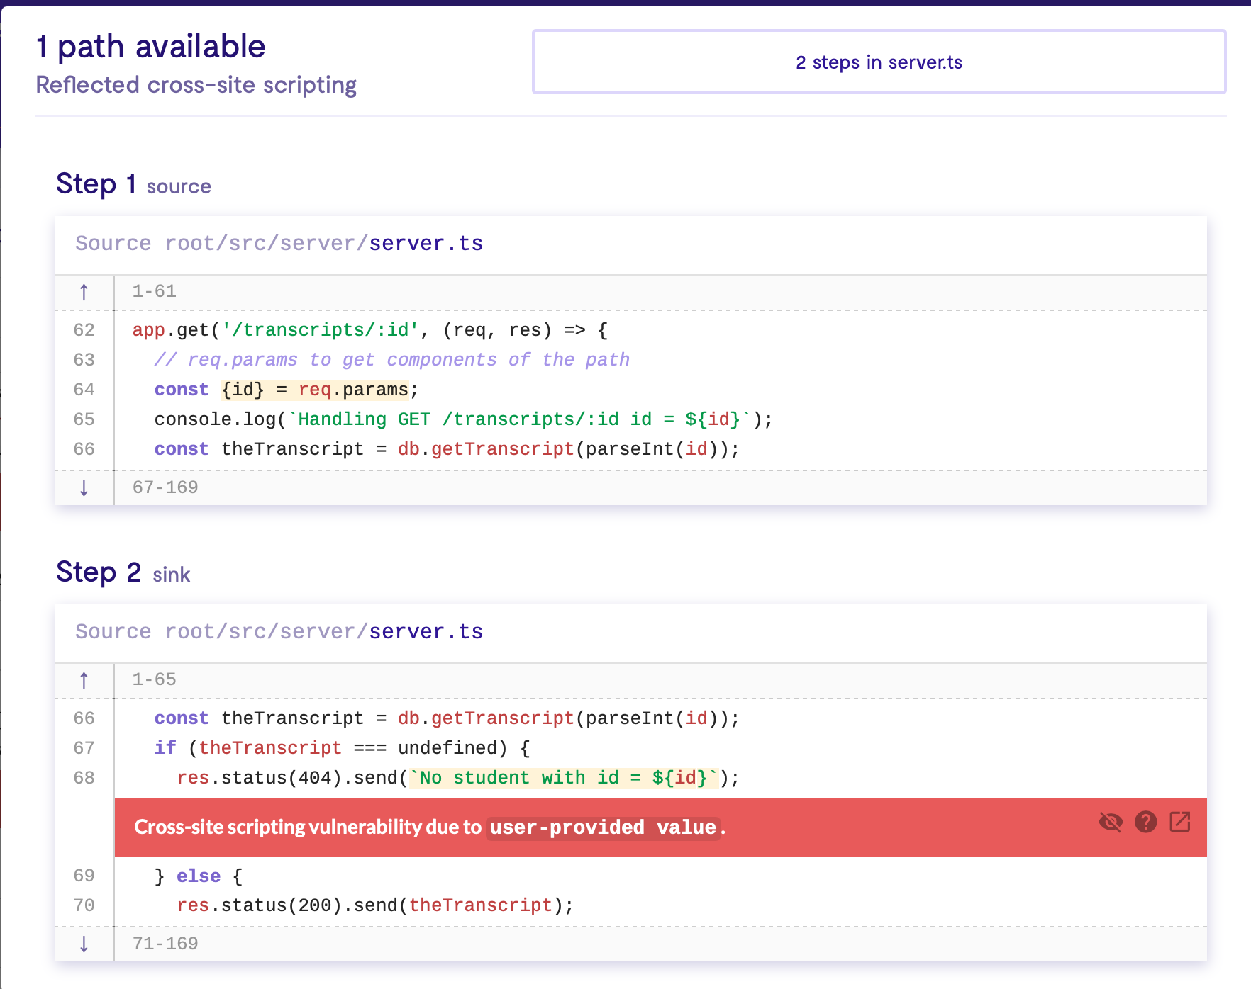
Code Injection
OWASP #3
Sanitize user-controlled inputs (remove HTML)
Use tools like LGTM to detect vulnerable data flows (insert into commit workflow?)
Use middleware that side-steps the problem (e.g. return data as JSON, client puts that data into React component) (how to get engineers to actually do this?)
Notes:
(read slide)
Screenshot on the right shows the LGTM tool identifying the cross-site scripting vulnerability that we discussed earlier

Slide 44
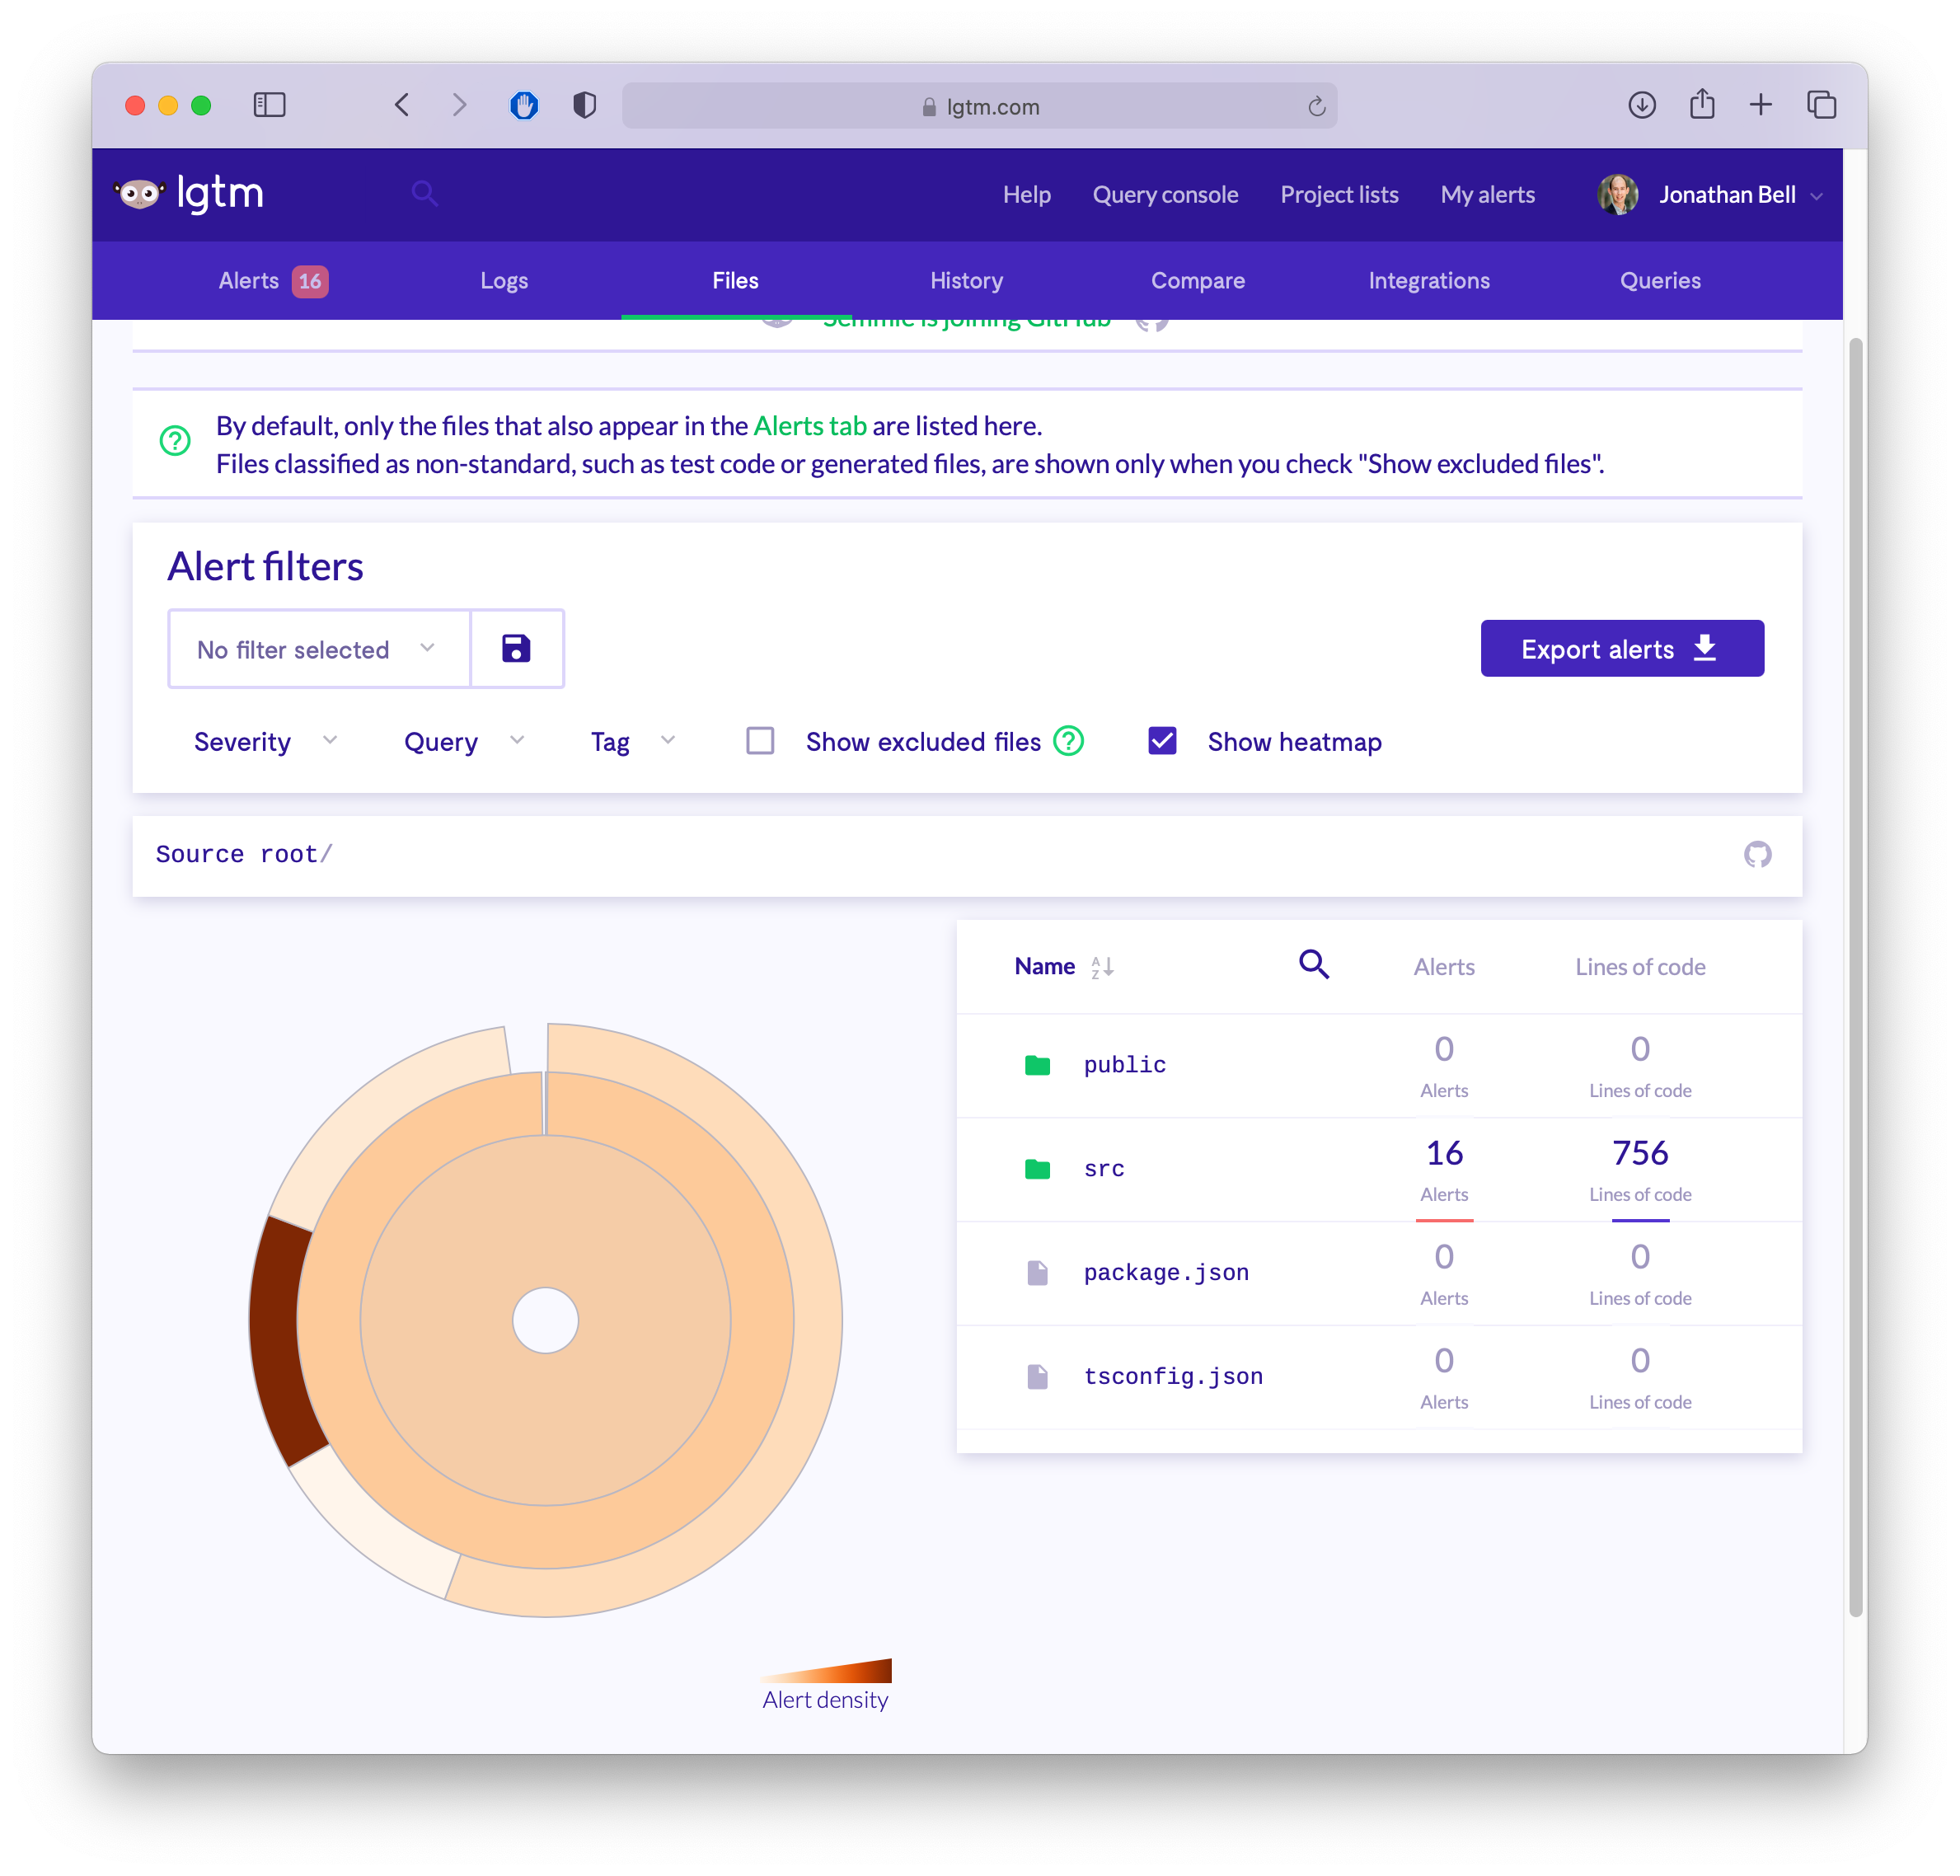
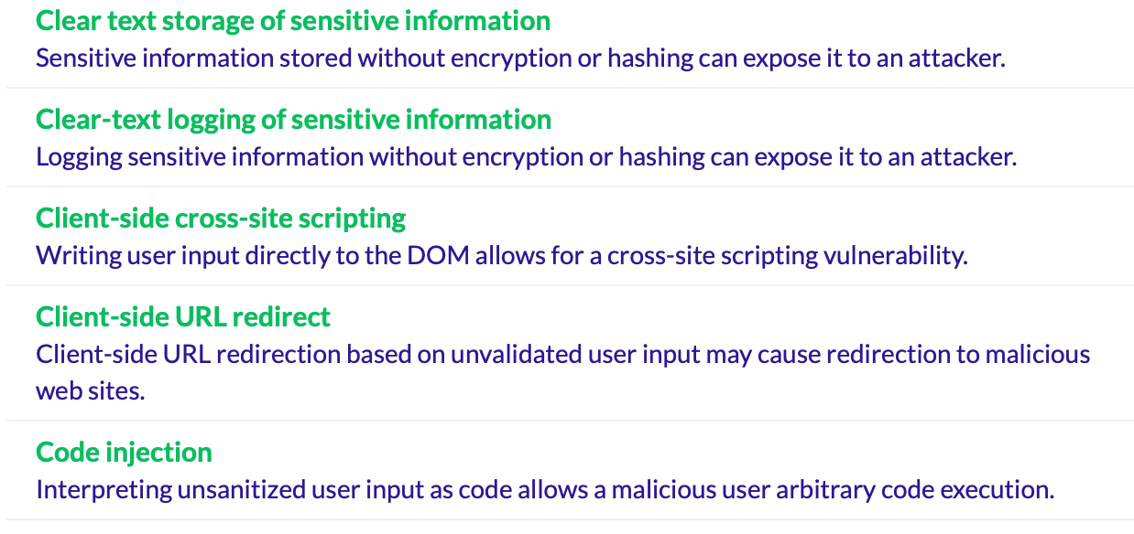
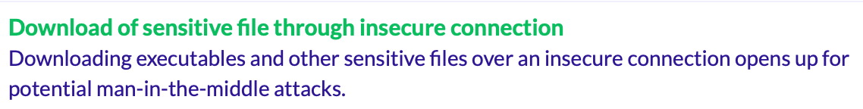
Detecting Weaknesses in Apps with Static Analysis
LGTM + CodeQL
But tools have both false positives and false negatives
https://lgtm.com
Notes:
LGTM can be used to detect other kinds of weaknesses, too – examples listed on right.
Of course, these tools are also imperfect – false positives (reports of things not exploitable) and false negatives (missed vulnerabilities). Still need to rely on human judgement.

Slide 45
Weakly Protected Sensitive Data
OWASP #4
Classify your data by sensitivity
Encrypt sensitive data - in transit and at rest
Make a plan for data controls, stick to it
Software engineering fix: can we avoid storing sensitive data?
Payment processors: Stripe, Square, etc

Slide 46
Learning Objectives for this Lesson
By the end of this lesson, you should be able to…
Define key terms relating to software/system security
Describe some of the tradeoffs between security and other requirements in software engineering
Explain 5 common vulnerabilities in web applications and similar software systems, and describe some common mitigations for each of them.
Explain why software alone isn’t enough to assure security

